Slide 1
Modern Web Scraping with Python

Slide 2


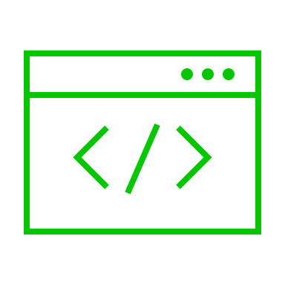
Web Scraping with Python
Extracting data from from websites
Benefits:
Automation
Low Maintenance
Accuracy
robots.txt (https://URL/robots.txt)
Notes:
(CLICK) web scraping with python allows you to extract particular data from websites in an automated fashion. Web scraping allows you to retrieve images, email address, URLs, and anything from a page
(CLICK) Some benefits include, (CLICK) automation; you are going to be able access data with 1 push of a button. (CLICK) Next, we have Low maintenance; programs are going to need little to no maintenance over time. (CLICK) Accuracy; human error is now out of the equation compared to manually fetching data on the web.
(CLICK) Every site now contains a robots.txt. This file is used to manage “crawler” traffic on a specific site, as well as describes which pages a crawler can access.

Slide 3
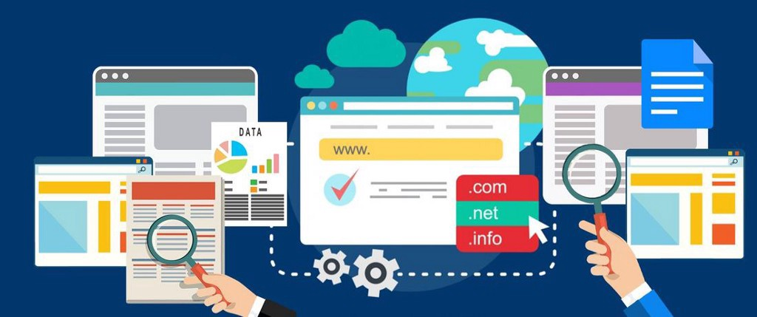
BeautifulSoup
Python library
Parsing
Notes:
(CLICK) Beautiful Soup is a python library that makes it easy to scrape information on the web.
(CLICK) It creates a tree that you can parse in HTML, XML, and other markup languages for relevant data and information

Slide 4
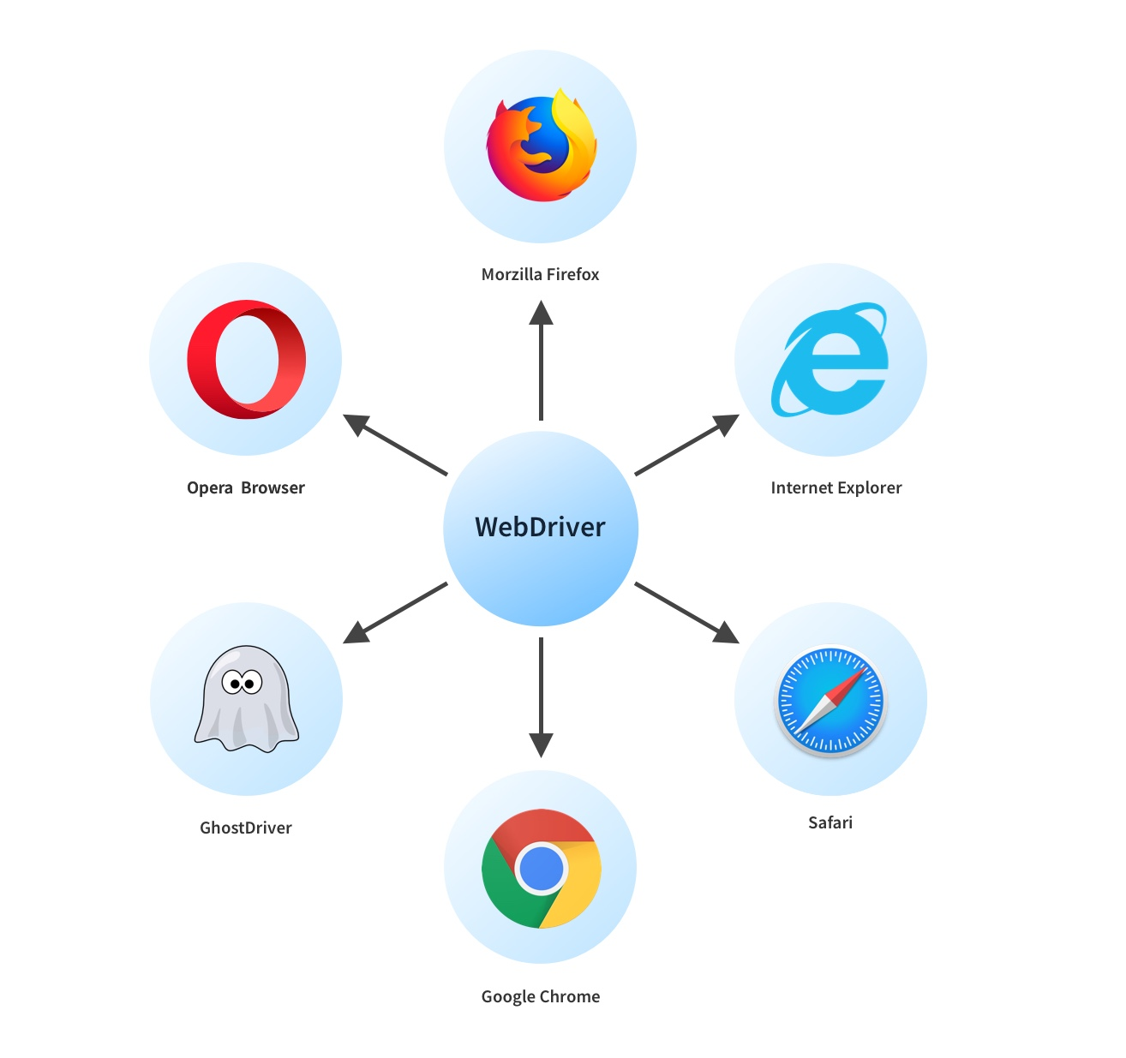
Selenium
Automate testing
Python library
Only requires a web driver executable
Notes:
(CLICK) Selenium WebDriver is a framework originally made for automating web-based application testing to verify the applications performance
(CLICK) You can use selenium library within the python programming language. This library allows you to create scripts in python to automate interactions with you web browser. (CLICK) this library only requires a browser specific executable
(CLICK) For my demo I’ll be using a script that I made a while back that uses BeatifulSoup and Selenium to scrape job postings from the Workday site that many companies use

